Slide 1
Hierarchical Clustering
Adapted from Slides by Prabhakar Raghavan, Christopher Manning, Ray Mooney and Soumen Chakrabarti

Slide 2
“The Curse of Dimensionality”
Why document clustering is difficult
  While clustering looks intuitive in 2 dimensions, many of our applications involve 10,000 or more dimensions…
  High-dimensional spaces look different
    The probability of random points being close drops quickly as the dimensionality grows.
    Furthermore, random pair of vectors are all almost perpendicular.
Notes:
Docs contain different words.

Slide 3
Today’s Topics
Hierarchical clustering
  Agglomerative clustering techniques
Evaluation
Term vs. document space clustering
Multi-lingual docs
Feature selection
Labeling

Slide 4
Hierarchical Clustering
Build a tree-based hierarchical taxonomy (dendrogram) from a set of documents.
One approach: recursive application of a partitional clustering algorithm.
animal
vertebrate
invertebrate
fish reptile amphib. mammal worm insect crustacean

Slide 5
Dendogram: Hierarchical Clustering
  Clustering obtained by cutting the dendrogram at a desired level: each connected component forms a cluster.

Slide 6
Hierarchical Clustering algorithms
Agglomerative (bottom-up):
  Start with each document being a single cluster.
  Eventually all documents belong to the same cluster.
Divisive (top-down):
  Start with all documents belong to the same cluster.
  Eventually each node forms a cluster on its own.
Does not require the number of clusters k in advance
Needs a termination/readout condition
  The final mode in both Agglomerative and Divisive is of no use.

Slide 7
Hierarchical Agglomerative Clustering (HAC) Algorithm
Start with all instances in their own cluster.
Until there is only one cluster:
Among the current clusters, determine the two
clusters, c_{i} and c_{j}, that are most similar.
Replace c_{i} and c_{j} with a single cluster c_{i} ∪ c_{j}
Notes:
Consider agglomerative clustering on n points on a line. Explain how you could avoid n³ distance computations - how many will your scheme use?

Slide 8
Dendrogram: Document Example
As clusters agglomerate, docs likely to fall into a hierarchy of “topics” or concepts.
d3
d5
d1
d3,d4,d5
d4
d2
d1,d2
d4,d5
d3

Slide 9
Key notion: cluster representative
We want a notion of a representative point in a cluster, to represent the location of each cluster
Representative should be some sort of “typical” or central point in the cluster, e.g.,
  point inducing smallest radii to docs in cluster
  smallest squared distances, etc.
  point that is the “average” of all docs in the cluster
    Centroid or center of gravity
    Measure intercluster distances by distances of centroids.

Slide 10
Example: n=6, k=3, closest pair of centroids
d6
d4
d3
d5
Centroid after
second step.
d1
d2
Centroid after first step.

Slide 11
Outliers in centroid computation
Can ignore outliers when computing centroid.
What is an outlier?
  Lots of statistical definitions, e.g.
  moment of point to centroid > M × some cluster moment.
Say 10.
Centroid
Outlier

Slide 12
Closest pair of clusters
Many variants to defining closest pair of clusters
Single-link
  Similarity of the most cosine-similar (single-link)
Complete-link
  Similarity of the “furthest” points, the least cosine-similar
Centroid
  Clusters whose centroids (centers of gravity) are the most cosine-similar
Average-link
  Average cosine between pairs of elements

Slide 13
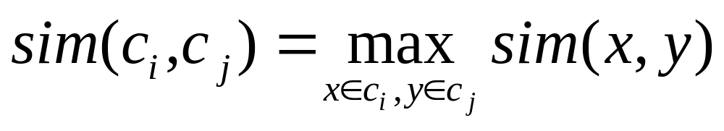
Single Link Agglomerative Clustering
Use maximum similarity of pairs:
Can result in “straggly” (long and thin) clusters due to chaining effect.
After merging c_{i} and c_{j}, the similarity of the resulting cluster to another cluster, c_{k}, is:

Slide 14
Single Link Example

Slide 15
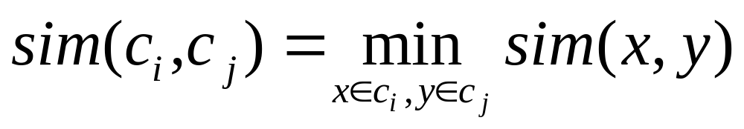
Complete Link Agglomerative Clustering
Use minimum similarity of pairs:
Makes “tighter,” spherical clusters that are typically preferable.
After merging c_{i} and c_{j}, the similarity of the resulting cluster to another cluster, c_{k}, is:
C_{i}
C_{j}
C_{k}

Slide 16
Complete Link Example

Slide 17
Computational Complexity
In the first iteration, all HAC methods need to compute similarity of all pairs of n individual instances which is O(n²).
In each of the subsequent n−2 merging iterations, compute the distance between the most recently created cluster and all other existing clusters.
In order to maintain an overall O(n²) performance, computing similarity to each cluster must be done in constant time.
  Else O(n² log n) or O(n³) if done naively
Notes:
Iteration one: n^2 distances
Computing distances from newly formed cluster = o(n)
Subsequent iterations = o(n)
So overall complexity for subsequent iterations: o(n^2)

Slide 18
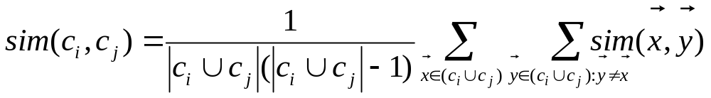
Group Average Agglomerative Clustering
Use average similarity across all pairs within the merged cluster to measure the similarity of two clusters.
Compromise between single and complete link.
Two options:
  Averaged across all ordered pairs in the merged cluster
  Averaged over all pairs between the two original clusters
Some previous work has used one of these options; some the other. No clear difference in efficacy
Notes:
Weighted average can be computed efficiently (remember avg and number of points)

Slide 19
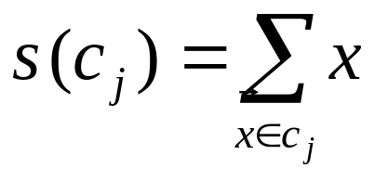
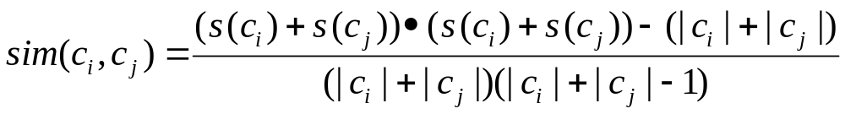
Computing Group Average Similarity
Assume cosine similarity and normalized vectors with unit length.
Always maintain sum of vectors in each cluster.
Compute similarity of clusters in constant time:

Slide 20
Efficiency: Medoid As Cluster Representative
The centroid does not have to be a document.
Medoid: A cluster representative that is one of the documents
For example: the document closest to the centroid
One reason this is useful
  Consider the representative of a large cluster (>1000 documents)
  The centroid of this cluster will be a dense vector
  The medoid of this cluster will be a sparse vector
Compare: mean/centroid vs. median/medoid

Slide 21
Efficiency: “Using approximations”
In standard algorithm, must find closest pair of centroids at each step
Approximation: instead, find nearly closest pair
  use some data structure that makes this approximation easier to maintain
  simplistic example: maintain closest pair based on distances in projection on a random line
Random line

Slide 22
Term vs. document space
So far, we clustered docs based on their similarities in term space
For some applications, e.g., topic analysis for inducing navigation structures, can “dualize”
  use docs as axes
  represent (some) terms as vectors
  proximity based on co-occurrence of terms in docs
  now clustering terms, not docs

Slide 23
Term vs. document space
Cosine computation
  Constant for docs in term space
  Grows linearly with corpus size for terms in doc space
Cluster labeling
  Clusters have clean descriptions in terms of noun phrase co-occurrence
Application of term clusters
Notes:
Cf. Latent Semantic Indexing

Slide 24
Multi-lingual docs
E.g., Canadian government docs.
Every doc in English and equivalent French.
  Must cluster by concepts rather than language
Simplest: pad docs in one language with dictionary equivalents in the other
  thus each doc has a representation in both languages
Axes are terms in both languages

Slide 25
Feature selection
Which terms to use as axes for vector space?
Large body of (ongoing) research
IDF is a form of feature selection
  Can exaggerate noise e.g., mis-spellings
Better to use highest weight mid-frequency words – the most discriminating terms
Pseudo-linguistic heuristics, e.g.,
  drop stop-words
  stemming/lemmatization
  use only nouns/noun phrases
Good clustering should “figure out” some of these

Slide 26
Major issue - labeling
After clustering algorithm finds clusters - how can they be useful to the end user?
Need pithy label for each cluster
  In search results, say “Animal” or “Car” in the jaguar example.
  In topic trees (Yahoo), need navigational cues.
    Often done by hand, a posteriori.
Notes:
News doc cluster labels

Slide 27
How to Label Clusters
Show titles of typical documents
  Titles are easy to scan
  Authors create them for quick scanning!
  But you can only show a few titles which may not fully represent cluster
Show words/phrases prominent in cluster
  More likely to fully represent cluster
  Use distinguishing words/phrases
    Differential labeling
Notes:
Cf. News docs appl

Slide 28
Labeling
Common heuristics - list 5-10 most frequent terms in the centroid vector.
  Drop stop-words; stem.
Differential labeling by frequent terms
  Within a collection “Computers”, clusters all have the word computer as frequent term.
  Discriminant analysis of centroids.
Perhaps better: distinctive noun phrase

Slide 29
What is a Good Clustering?
Internal criterion: A good clustering will produce high quality clusters in which:
  the intra-class (that is, intra-cluster) similarity is high
  the inter-class similarity is low
  The measured quality of a clustering depends on both the document representation and the similarity measure used

Slide 30
External criteria for clustering quality
Quality measured by its ability to discover some or all of the hidden patterns or latent classes in gold standard data
Assesses a clustering with respect to ground truth
Assume documents with C gold standard classes, while our clustering algorithms produce K clusters, ω₁, ω₂, …, ω_{K} with n_{i} members.

Slide 31
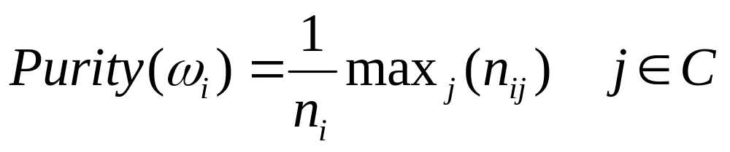
External Evaluation of Cluster Quality
Simple measure: purity, the ratio between the dominant class in the cluster π_{i} and the size of cluster ω_{i}
Others are entropy of classes in clusters (or mutual information between classes and clusters)

Slide 32
Purity example
• •
• •
• •
• •
• •
• •
• •
• •
•
Cluster I
Cluster II
Cluster III
Cluster I: Purity = 1/6 (max(5, 1, 0)) = 5/6
Cluster II: Purity = 1/6 (max(1, 4, 1)) = 4/6
Cluster III: Purity = 1/5 (max(2, 0, 3)) = 3/5

Slide 33
Rand Index
Number of points | Same Cluster in clustering | Different Clusters in clustering
Same class in ground truth | A | C
Different classes in ground truth | B | D

Slide 34
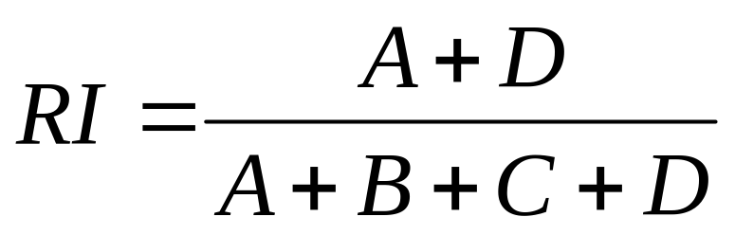
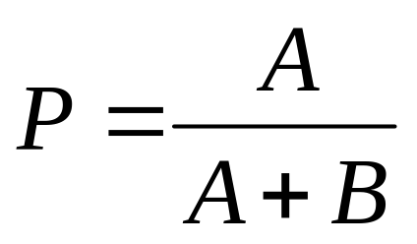
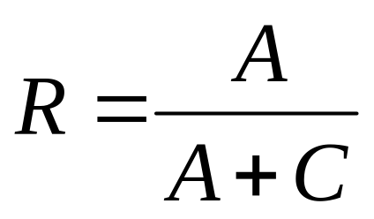
Rand index: symmetric version
Compare with standard Precision and Recall.

Slide 35
Rand Index example: 0.68
Number of points | Same Cluster in clustering | Different Clusters in clustering
Same class in ground truth | 20 | 24
Different classes in ground truth | 20 | 72
Notes:
20+72 / 20 + 20 + 24 + 72 = 92 / 136 = 0.68

Slide 36
SKIP WHAT FOLLOWS

Slide 37
Evaluation of clustering
Perhaps the most substantive issue in data mining in general:
  how do you measure goodness?
Most measures focus on computational efficiency
  Time and space
For application of clustering to search:
  Measure retrieval effectiveness

Slide 38
Approaches to evaluating
  Anecdotal
  User inspection
  Ground “truth” comparison
    Cluster retrieval
  Purely quantitative measures
    Probability of generating clusters found
    Average distance between cluster members
  Microeconomic / utility

Slide 39
Anecdotal evaluation
Probably the commonest (and surely the easiest)
  “I wrote this clustering algorithm and look what it found!”
No benchmarks, no comparison possible
Any clustering algorithm will pick up the easy stuff like partition by languages
Generally, unclear scientific value.

Slide 40
User inspection
Induce a set of clusters or a navigation tree
Have subject matter experts evaluate the results and score them
  some degree of subjectivity
Often combined with search results clustering
Not clear how reproducible across tests.
Expensive / time-consuming

Slide 41
Ground “truth” comparison
Take a union of docs from a taxonomy & cluster
  Yahoo!, ODP, newspaper sections …
Compare clustering results to baseline
  e.g., 80% of the clusters found map “cleanly” to taxonomy nodes
  How would we measure this?
But is it the “right” answer?
  There can be several equally right answers
For the docs given, the static prior taxonomy may be incomplete/wrong in places
  the clustering algorithm may have gotten right things not in the static taxonomy
“Subjective”

Slide 42
Ground truth comparison
Divergent goals
Static taxonomy designed to be the “right” navigation structure
  somewhat independent of corpus at hand
Clusters found have to do with vagaries of corpus
Also, docs put in a taxonomy node may not be the most representative ones for that topic
  cf Yahoo!

Slide 43
Microeconomic viewpoint
Anything - including clustering - is only as good as the economic utility it provides
For clustering: net economic gain produced by an approach (vs. another approach)
Strive for a concrete optimization problem
Examples
  recommendation systems
  clock time for interactive search
    expensive

Slide 44
Evaluation example: Cluster retrieval
Ad-hoc retrieval
Cluster docs in returned set
Identify best cluster & only retrieve docs from it
How do various clustering methods affect the quality of what’s retrieved?
Concrete measure of quality:
  Precision as measured by user judgements for these queries
Done with TREC queries

Slide 45
Evaluation
Compare two IR algorithms
  1. send query, present ranked results
  2. send query, cluster results, present clusters
Experiment was simulated (no users)
  Results were clustered into 5 clusters
  Clusters were ranked according to percentage relevant documents
  Documents within clusters were ranked according to similarity to query

Slide 46
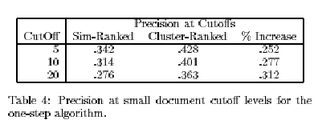
Sim-Ranked vs. Cluster-Ranked

Slide 47
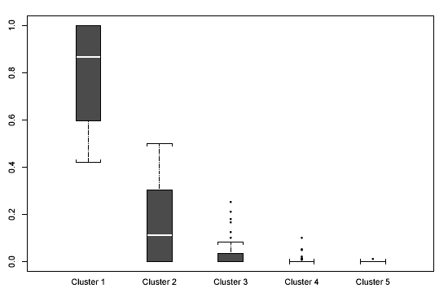
Relevance Density of Clusters

Slide 48
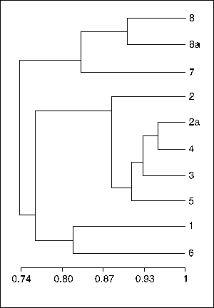
Buckshot Algorithm
Cut where
You have k
clusters
Another way to an efficient implementation:
  Cluster a sample, then assign the entire set
Buckshot combines HAC and K-Means clustering.
First randomly take a sample of instances of size √n
Run group-average HAC on this sample, which takes only O(n) time.
Use the results of HAC as initial seeds for K-means.
Overall algorithm is O(n) and avoids problems of bad seed selection.
Uses HAC to bootstrap K-means

Slide 49
Bisecting K-means
Divisive hierarchical clustering method using K-means
For I=1 to k-1 do {
  Pick a leaf cluster C to split
  For J=1 to ITER do {
    Use K-means to split C into two sub-clusters, C₁ and C₂
    Choose the best of the above splits and make it permanent}
    }
  }
Steinbach et al. suggest HAC is better than k-means but Bisecting K-means is better than HAC for their text experiments
Notes:
Consider running 2-means clustering on a corpus, each doc of which is from one of two different languages. What are the two clusters we would expect to see?
Is agglomerative clustering likely to produce different results to the above?
Is the centroid of normalized vectors normalized?
Suppose a run of agglomerative clustering finds k=7 to have the highest value amongst all k. Have we found the highest-value clustering amongst all clusterings with k=7?

